Slide 1
Marketing Analytics Project — ShopEasy
-YASH KHOBRAGADE

Slide 2
INTRODUCTION
ShopEasy, an online retail business, is facing reduced customer engagement and conversion rates despite launching several new online marketing campaigns. They are reaching out to you to help conduct a detailed analysis and identify areas for improvement in their marketing strategies.
Key Points:
Reduced Customer Engagement: The number of customer interactions and engagement with the site and marketing content has declined.
Decreased Conversion Rates: Fewer site visitors are converting into paying customers.
High Marketing Expenses: Significant investments in marketing campaigns are not yielding expected returns.
Need for Customer Feedback Analysis: Understanding customer opinions about products and services is crucial for improving engagement and conversions.

Slide 3
Business Challenges
Reduced Customer Engagement: Fewer interactions with site and marketing content.
Decreased Conversion Rates: Fewer site visitors are converting into paying customers.
High Marketing Expenses: Investments are not delivering ROI.
Need for Customer Feedback Analysis: Understand customer opinions to improve engagement.
Project Goals
Increase Conversion Rates:
Identify drop-off points and improve the conversion funnel.
Enhance Customer Engagement:
Find the most engaging content types and strategize accordingly.
Improve Customer Feedback Scores:
Identify recurring feedback themes and offer actionable recommendations.

Slide 4
Tools and Technologies Used
SQL: Data extraction and cleaning
Python: Data analysis and sentiment analysis
Power BI: Data visualization and dashboard creation
Data Collection and Preparation
Sources: Github Repository
Cleaning: Handled missing values, structured data for analysis
Feature Engineering: Created new metrics for engagement, conversion, and sentiment

Slide 5
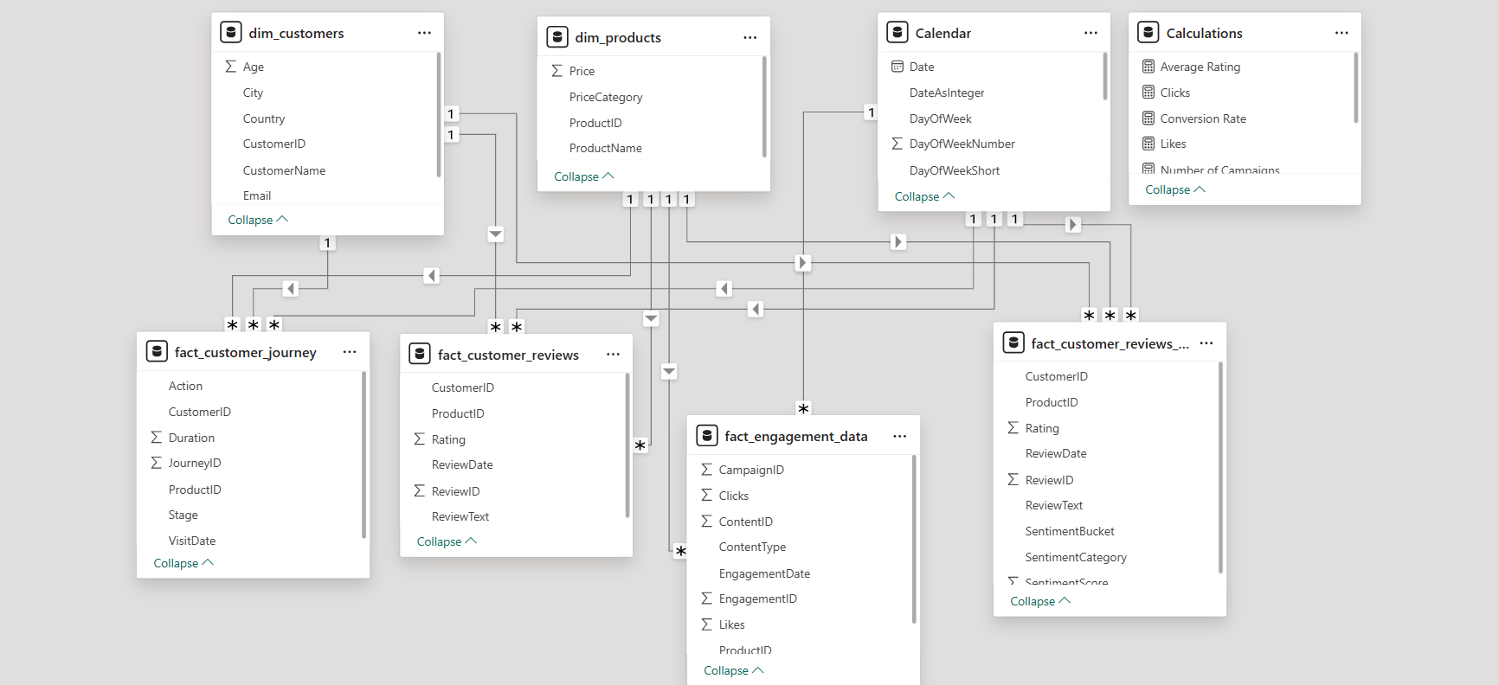
SQL Model Diagram
ER Diagram: Shows tables, relationships, and key columns.
SQL Workflow Flowchart: Visualizes data flow from raw tables → cleaning → analysis → Power BI visualization.
Data Pipeline Overview: SQL (data extraction) → Python (analysis) → Power BI (dashboard).

Slide 6
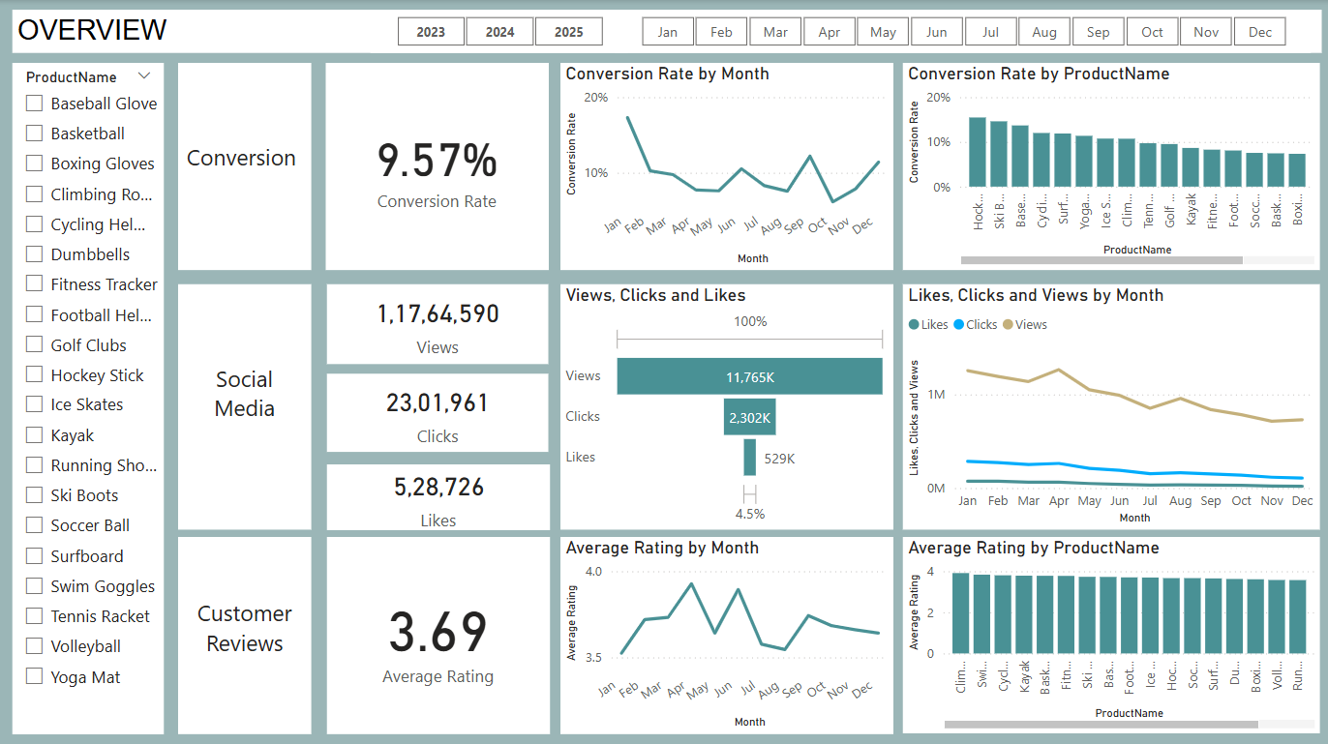
Power BI Dashboard Overview

Slide 7
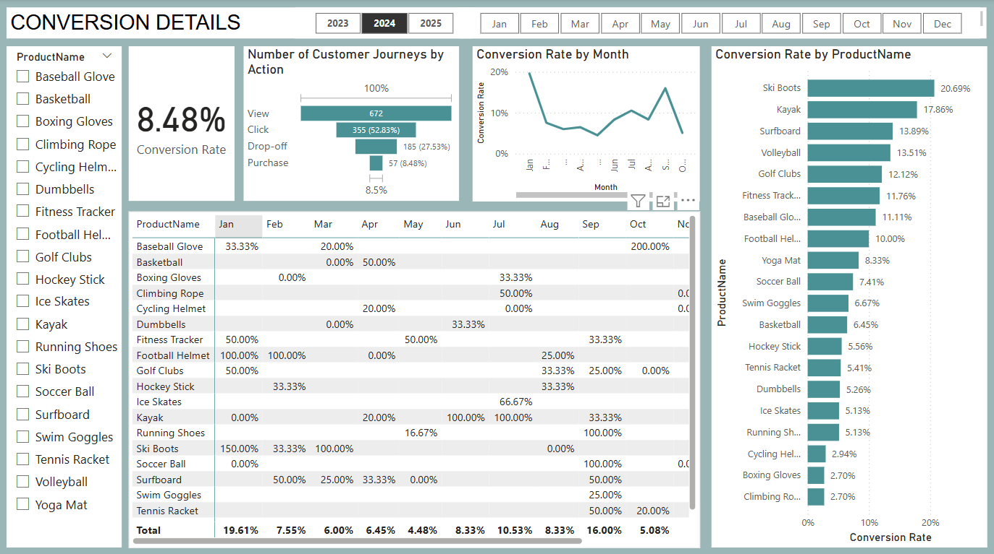
Power BI Dashboard Overview

Slide 8
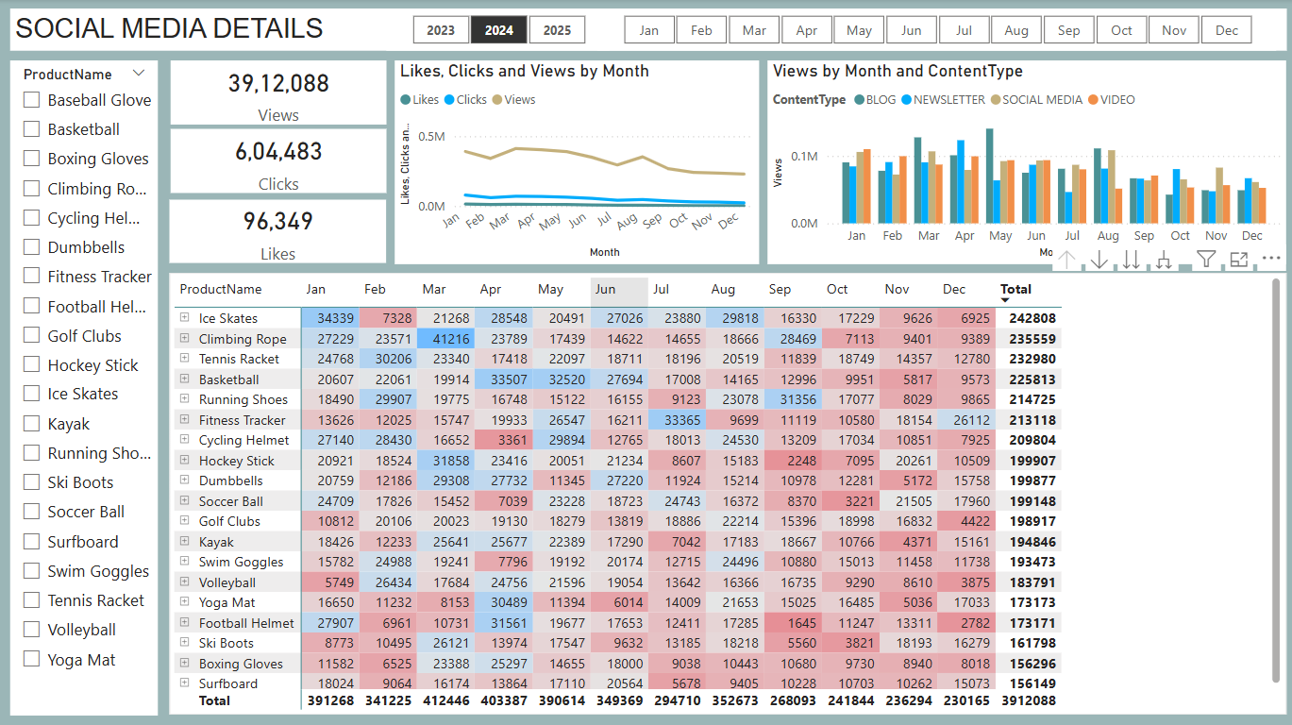
Power BI Dashboard Overview

Slide 9
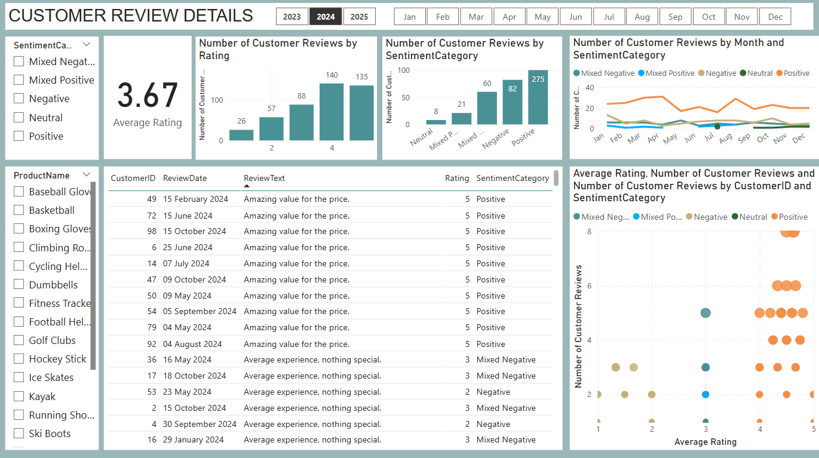
Power BI Dashboard Overview

Slide 10
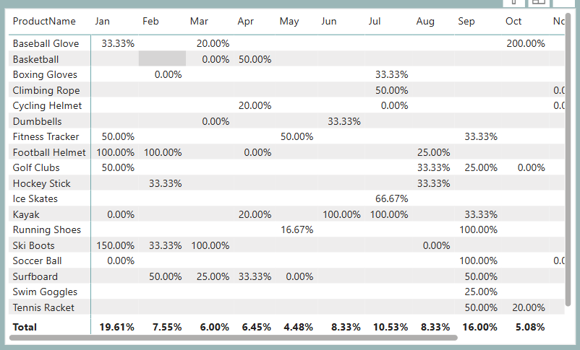
Data Analysis & Insights
Conversion Rate Analysis
General Trends: Fluctuations across months, highest conversion in January (19.61%, driven by Ski Boots)
Lowest Conversion Month: May (4.48%), no standout products
Insight: Seasonal products convert better — focus on January/September
Recommendations & Actions
For Conversion Rates:
Focus on high-converting products like Ski Boots, Kayaks, and Baseball Gloves
Implement seasonal promotions (January & September)

Slide 11
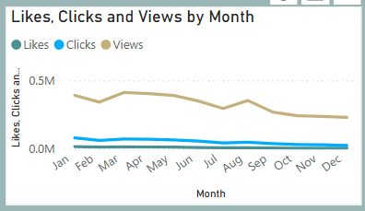
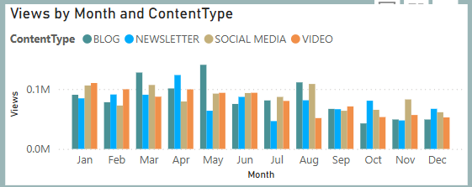
Data Analysis & Insights
b) Engagement Analysis
Declining Views: Engagement peaked in February and July, dropped after August
Content Performance: Blogs performed best, social media and video engagement stayed steady but lower
Insight: Boost engagement with interactive and user-generated content
Recommendations and Actions
For Engagement:
Create interactive content (e.g., quizzes, videos)
Improve call-to-action placements, especially during low-engagement months (September-December)

Slide 12
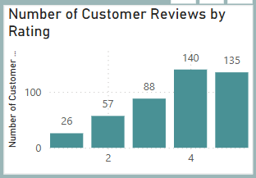
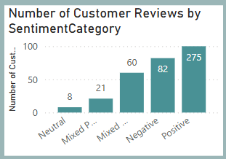
Data Analysis & Insights
c) Customer Feedback Analysis
Sentiment Breakdown: 275 positive, 82 negative, 26 one-star reviews
Common Issues: Mixed reviews highlight areas for product/service improvement
Insight: Address mixed feedback to boost overall satisfaction scores closer to 4.0
Recommendations and Actions
For Feedback Scores:
Implement a feedback loop to track and resolve issues from mixed/negative reviews
Follow up with dissatisfied customers to encourage updated reviews

Slide 13
Conclusion
Key Takeaways:
Focus on high-performing products
Revamp content strategy
Address customer feedback effectively
Business Impact: Data-driven strategy to boost conversions, engagement, and satisfaction

Slide 14
THANK YOU !

